Slide 1
Laboratory of Analytical chemistry
Experimental 3:
Determination of the percentage of Acetic acid in a Vinegar sample
Determination of acetic acid concentration in commercially available white vinegar is one of the simplest and easiest titrations.
It is also possible to determine concentration of acetic acid in other types of vinegar. The only problem is that the color of the vinegar can make it difficult to spot the end point. We have to remember that vinegars-apart from acetic acid -contain also many other organic acids, responsible for the vinegar flavor. Their concentrations are usually low compared with concentration of acetic acid, but to be precise we should mention that we are determining not just acetic acid, but sum of all acids present in the vinegar.
This is a simple neutralization reaction(weak acid-strong Base):
CH₃COOH + NaOH → CH₃COO-Na+ + H₂O
Depending on the equivalence point for acetic acid with sodium hydroxide by titration method that lies somewhere between pH 8-9, When titrating with phenolphthalein indicator as starts to change its color around pH 8.2, which makes it a perfect indicator for the end point detection.

Slide 2
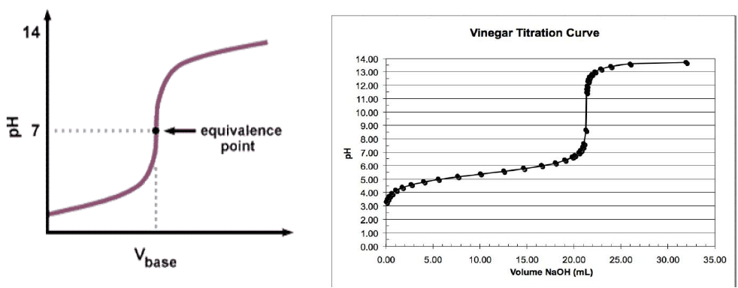
Titration curve:

